Slide 1
Enstor Employee Benefits Overview
January 1, 2026 – December 31, 2026
Notes:
Welcome to Enstor’s Benefit Enrollment.
Enstor offers a robust and competitive benefits package, and we want you to understand your benefits and the value they represent to you and your family.
Please watch this video carefully so that you can make the decisions that best suit your needs. You can refer back to any portion of this video as often as you’d like.

Slide 2
AGENDA
What you need to know!
What’s new in 2026?
Benefits Overview
Next steps
Q&A

Slide 3
WHAT YOU NEED TO KNOW
The benefits you elect during this Open Enrollment period will be in effect from January 1 – December 31, 2026.
This year’s Open Enrollment will be an active enrollment.
  Your current benefits will not automatically roll over if you do not participate in Open Enrollment.
Open Enrollment will be from November 10th through November 21st.
Elections and waivers will be due no later than November 21^{st.}
Notes:
A few important things to know –
This year’s open enrollment will be an active enrollment meaning your current benefits will not automatically roll over if you do not participate in Open Enrollment.
Open enrollment will begin November 10th through November 21st.
Elections and waivers will be due no later than November 21st.

Slide 4
WHAT’S NEW FOR 2026?
We will continue to offer medical and dental coverage through BCBS. There are a few plan design updates for both the HDHP and PPO options. Employer contributions to the HSA will increase slightly for 2026.
We are switching to UNUM for STD, LTD, Life and AD&D. Life insurance is the only plan that will remain the same if you don’t make any changes during enrollment. If you’d like to adjust your coverage over the Guaranteed issue amount, you’ll need to take action by submitting an Evidence of Insurability.
Employee contributions for medical and dental coverage will increase slightly, while vision contributions the same for 2026.
Please note there are 27 pay periods in 2026 (instead of 26). Benefit materials will reflect cost distribution over 27 pay periods.
Notes:
We want to be sure you understand what’s new and changing for 2026, so you can put these plans to work for you.
BCBS remains medical provider with plan adjustments
HSA employer contributions will be increasing
In 2026, Unum will now administer the life and disability benefits.
Benefit materials will reflect cost distribution over 27 pay periods.

Slide 5
ENROLLMENT AND ELIGIBILITY
As part of the Company’s total benefit package, regular, full-time employees and part-time employees working a regular schedule of at least 30 hours per week are eligible to participate in certain insurance and benefit programs.
For many benefits, you may also enroll your eligible dependents.
Eligible dependents include your:
Legally married spouse
Domestic Partner and children
Natural or adopted child(ren) or stepchild(ren) up to the age of 26
Any other child as defined in the certificate of coverage
Your child over the age of 26 who is mentally or physically handicapped
and incapable of self-care
Notes:
You are eligible for Enstor’s employee benefits if you are a regular, full-time or part-time employee scheduled to work 30 or more hours per week. You may also enroll your eligible dependents in many of the benefit plans. These dependents include your legally married spouse, your domestic partner, your natural or adopted children or stepchildren, or any other child as defined in the certificate of coverage, up to the age they turn 26. You can also enroll your child over the age of 26 if they are mentally or physically incapable of self care.

Slide 6
QUALIFYING LIFE EVENTS
You cannot make any changes to your benefit elections during the year unless you experience a Qualifying Life Event. This applies to Medical, Dental, Vision, Health Care or Dependent Care Flexible Spending Accounts.
Examples of a Qualified Life Event:
  The birth or death of a dependent
  Marriage or divorce
  A change in employment status
  If you experience a Qualifying Life Event, you must submit documentation and update your benefit elections in Paycom within 30 days of the event.
Notes:
You cannot make any changes to your benefit elections during the year unless you experience a Qualifying Life Event, such as the birth of a dependent, a marriage or divorce or a change in employment status. This applies to medical, dental, vision, health care or dependent care flexible spending accounts. If you do experience a qualifying life event, you must submit documentation and update your benefit elections in Paycom within 30 days of the event.

Slide 7

ALEX POWERED BY JELLYVISION
Make better benefits choices with ALEX.
Because you shouldn’t need a PhD to pick a health plan.
ALEX is an interactive online experience designed to help you make confident choices about your benefits during enrollment. Just answer a few questions about your preferences and health care needs, and ALEX can narrow it down to only show you plan options that give you the best coverage for the lowest cost.
FAST & FRIENDLY
SMARTER THAN EVER
TOTALLY CONFIDENTIAL
Notes:
ALEX is an interactive online experience designed to help you make confident choices about your benefits during enrollment. Just answer a few questions about your preferences and health care needs, and ALEX can narrow it down to only show you plan options that give you the best coverage for the lowest cost.
FAST & FRIENDLY
Using ALEX is sort of like chatting with a smart, funny friend (who happens to have memorized all of your employer’s plan documents). In less than 15 minutes, you’ll create a plan of action you can use to speed through enrollment.
TOTALLY CONFIDENTIAL
ALEX is available to chat any time, day or night, at work or at home. Your responses are totally private and won’t be shared with your employer, so you can explore freely.
SMARTER THAN EVER
ALEX has a new decision-making engine under the hood that harnesses the power of AI to analyze your responses and make sure suggested plans fit your risk tolerance, financial situation, and have been proven to work for others like you.

Slide 8
COST OVERVIEW | WHO PAYS?
 | Enstor | You | Shared
Medical |  |  | ✓
Health Savings Account (HSA) |  |  | ✓
Cash in Lieu Program | ✓
Dental |  |  | ✓
Vision | ✓
FSA |  | ✓
Basic Life/AD&D | ✓
Voluntary Life/AD&D |  | ✓
Accident, Critical Illness, and Hospital Indemnity |  | ✓
Short Term and Long-Term Disability | ✓
Employee Assistance Program | ✓
Notes:
Here you will find a cost overview of benefits Enstor pays for, which benefits you pay for, and which are shared between the two.

Slide 9
MEDICAL PLANS
Administered by
Blue Cross Blue Shield of Texas

Slide 10

MEDICAL PLAN COMPARISON | HDHP vs PPO
 | BCBSTX HDHP with HSA |  |  | BCBSTX PPO
 | In-Network | Out-of-Network |  | In-Network | Out-of-Network
Individual Deductible | $3,500 | $7,000 |  | $1,500 | $3,000
Family Deductible | $7,000 | $14,000 |  | $4,500 | $9,000
Individual Out-of-Pocket Max | $5,000 | Unlimited |  | $6,000 | Unlimited
Family Out-of-Pocket Max | $10,000 | Unlimited |  | $18,000 | Unlimited
Plan design change
No plan design change
Notes:
Enstor offers two benefit plans, the BCBSTX HDHP with HSA Plan and the BCBSTX PPO Plan. While there are some commonalities between plans, like coverage for office and hospital visits and free in-network preventive care, they differ in regard to their deductibles (the amount you pay before insurance kicks in), and their out-of-pocket maximums (the total amount you would be responsible for in any given plan year).

Slide 11
MEDICAL PLAN COMPARISON | HDHP vs PPO
 | BCBSTX HDHP with HSA |  | BCBSTX PPO
 | In-Network | Out-of-Network | In-Network | Out-of-Network
PCP / Specialist Office Visits | 20% after deductible | 40% after deductible | $40 / $80 copay | 40% after deductible
Emergency Room | 20% after deductible |  | $500 copay + 20% after deductible
Urgent Care | 20% after deductible | 40% after deductible | $75 copay | 40% after deductible
Minor X-Rays, Lab & Other Imaging | 20% after deductible | 40% after deductible | 20% after deductible | 40% after deductible
High-Cost Imaging (MRI, PET, CT scans) | 20% after deductible | 40% after deductible | 20% after deductible | 40% after deductible
Inpatient / Outpatient Hospital | 20% after deductible | 40% after deductible | 20% after deductible | 40% after deductible
Plan design change
No plan design change
Notes:
It is important to note that neither plan is considered “better” than the other, and that providers view them both equally.
For you, the difference lies in how and when you pay for services. You’ll notice that with the PPO Plan, there is a copay for office visits while with the High-Deductible Health Plan (HDHP), you are responsible for 100% of charges until your deductible is met, and then BCBS pays for 80% of the costs.
With the high-deductible health plan, it also means you are associated with a Health Savings Account (HSA), a savings benefit that you can keep should you decide to leave Enstor. We’ll discuss HSAs in more detail later in this presentation.

Slide 12
MEDICAL PLAN COMPARISON | PHARMACY COVERAGE
 | BCBSTX HDHP with HSA |  | BCBSTX PPO
 | In-Network | Out-of-Network | In-Network | Out-of-Network
Preferred Generic Drugs | 10% after deductible | Deductible + Coinsurance | $0 copay | Deductible + Coinsurance
Non-Preferred Generic Drugs | 10% after deductible |  | $10 copay
Preferred Brand Name Drugs | 20% after deductible |  | $50 copay
Non-Preferred Brand Name Drugs | 30% after deductible |  | $100 copay
Preferred Specialty Drugs | 40% after deductible |  | $150 copay
Non-Preferred Specialty Drugs | 50% after deductible |  | $250 copay
Plan design change
No plan design change
Notes:
Both plans also provide coverage for prescription drugs. You have the Preferred Pharmacy Network and Performance Annual Drug List offerings through Blue Cross Blue Shield of Texas. Remember that you can save money by using generic medication, as opposed to brand name, that often cost far less.
Your prescription drug benefit plan has Prior Authorization, Step Therapy and Dispensing Limit Programs. These programs are updated on an annual basis and promote save and proper use of medicines. Please note, select drugs that are new to the market may also need prior authorization.

Slide 13
MEDICAL PLAN COSTS | EMPLOYEE BI-WEEKLY PREMIUMS
2025
 | BCBSTX HDHP with HSA | BCBSTX PPO
Employee | $31.00 | $49.00
Employee + Spouse | $63.00 | $98.00
Employee + Child(ren) | $63.00 | $91.00
Employee + Family | $94.00 | $145.00
2026
 | BCBSTX HDHP with HSA | BCBSTX PPO
Employee | $30.45 | $48.60
Employee + Spouse | $61.88 | $97.20
Employee + Child(ren) | $61.88 | $90.26
Employee + Family | $92.33 | $143.82
2026 premiums paid over 27 pay periods
Notes:
Let’s look at the cost for participation in the 2026 plans in comparison to this years’ cost.

Slide 14
CASH IN LIEU PROGRAM
Employees who decide to Opt-Out of the Enstor Medical Plan to enroll in a spouse’s or parents’ eligible medical plan, will receive a total cash payment based on enrollment tier. These employees will be required to complete the Cash in Lieu Form:
Employee Only: $2,500 total cash payment
Employee + Spouse OR Employee + One Child: $3,500 total cash payment
Employee + Family: $5,000 total cash payment
Payment Structure - employee will receive 2 equal payments as follows:
1st Payment on the last pay day of January 2026
2nd Payment on the last pay day of July 2026
Prorated for new hires
Employees who opt out of the Enstor BCBSTX Medical plan are still able to enroll in the BCBSTX Dental plan. Enstor will continue to pay 100% of the Vision, Life and Disability plans.
Cash in Lieu Form is available in Human Resources
Notes:
Employees who decide to Opt-Out of the Enstor Medical Plan to enroll on their spouse’s eligible medical plan, will receive a total cash payment based on enrollment tier. These employees will be required to complete the Cash in Lieu Waiver Form (form available in HR or on Paycom).
Employees who opt out of the Enstor Blue Cross Blue Shield of Texas Medical plan are still able to enroll in the Blue Cross Blue Shield of Texas Dental plan. Enstor will continue to pay 100% of the Vision, Life and Disability plans.
In order to receive the opt-out payment, the employee must provide annual documentation that they (and their tax family members) have obtained MEC (Minimum Essential Coverage) coverage through a spouse’s group plan, or a parent’s group plan – but not coverage obtained in the individual market, Exchange or Marketplace, or Medicare, or Medicaid. Cash in Lieu Waiver Opt-Out Form is available in Human Resources .

Slide 15





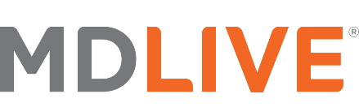
VIRTUAL VISITS | MDLIVE
Avoid germs in the ER, urgent care clinic or doctor’s office
See a board-certified, licensed, telehealth-trained doctor on you schedule with on-demand virtual visits 24/7, including nights, weekends and holidays.
Get treated for more than 80 common conditions including colds, flu, allergies and more.
Get a prescription or short-term refill of any existing prescription sent to a pharmacy nearby in less time than your usual doctor visit.
Avoid costly copays and deductibles of the ER and urgent care clinic.
BCBSTX HDHP with HSA | BCBSTX PPO
$48* | $0 Copay
*Virtual behavioral consultations are subject to separate pricing.

Slide 16
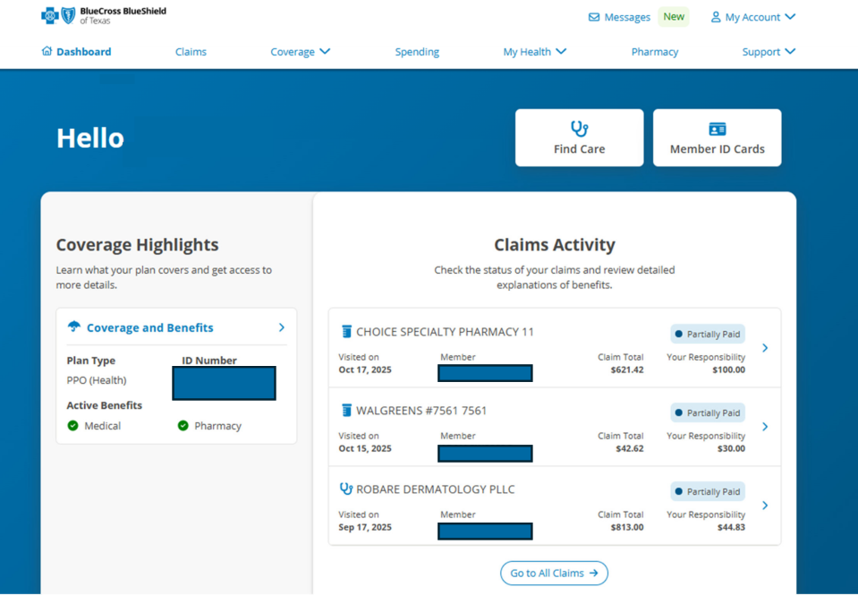
BCBS MEMBER PORTAL – BLUE ACCESS FOR MEMBERS (BAM)
Notes:
Your health at your fingertips. You can do it all – simply and securely – on Blue Access for Members (BAM).
Using the BAM Dashboard, you can view quick claims summaries or download your Explanation of Benefits (EOB), see benefit highlights for your medical, dental and pharmacy plans, keep track of your deductibles and out-of-pocket expenses and find in-network doctors, hospitals, and other health care providers quickly and easily.
Take control of your well-being with preventive care guidelines, information and health tips for managing health conditions and living a healthier life.
For everything else, you can use the “My Account” menu. View your health history, update your profile and preferences, sign up for electronic EOBs, find claim forms, manage privacy preferences and contact BCBS.

Slide 17
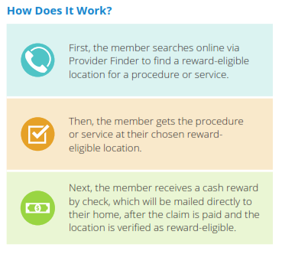
MEMBER REWARDS
Member Rewards is a comprehensive engagement and rewards program offered by Blue Cross and Blue Shield of Texas (BCBSTX). It is administered by Sapphire Digital and guides members to cost-effective options, helping achieve measurable savings for both employers and employees.
The Member Rewards program offers a cash reward to members when they shop for procedures or services, and select a low-cost, reward-eligible option. It uses the Provider Finder® tool, which helps members:
Compare costs and quality
Estimate out-of-pocket costs
Assist in making treatment decisions with their doctors
Notes:
Member Rewards is a comprehensive engagement and rewards program offered by Blue Cross and Blue Shield of Texas (BCBSTX). It is administered by Sapphire Digital and guides members to cost-effective options, helping achieve measurable savings for both employers and employees.
The Member Rewards program offers a cash reward to members when they shop for procedures or services, and select a low-cost, reward-eligible option

Slide 18
FLEXIBLE SPENDING ACCOUNT (FSA)
Administered by
HSA Bank
Notes:
Enstor’s Flexible Spending Account and Dependent Care Spending Account are administered by HSA Bank.
Employees may choose to contribute to either a Healthcare Flexible Spending Account (FSA) or a Dependent Care FSA (DCFSA).
A Healthcare FSA can be used to pay for your out-of-pocket expenses related to medical care, dental care and vision. You may contribute up to $3,400 pre-tax dollars annually. In accordance with the 2026 IRS limit.
Dependent Care FSA funds are reserved exclusively for eligible caregiving expenses – childcare up to age 13 and eldercare. You may contribute up to $7,500 pre-tax dollars annually.
If you do not spend all the money in your Healthcare FSA or Dependent Care FSA by March 31st of the following year for expenses incurred from January 1 – December 31, unused dollars will be forfeited per IRS regulations for pretax contributions.

Slide 19
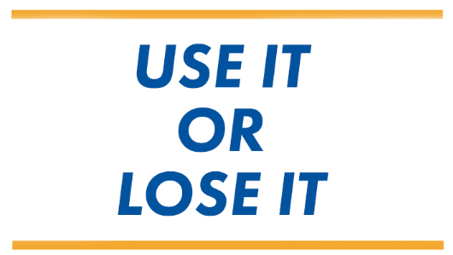

FLEXIBLE SPENDING ACCOUNT &
DEPENDENT CARE SPENDING ACCOUNT
HEALTHCARE FSA
Contribute up to $3,400 per year, pretax, to pay for copays, prescription expenses, lab exams and tests, contact lenses and eyeglasses, and dental expenses.
If you are a participant in HSA, you are not eligible for FSA
DEPENDENT CARE FSA
Contribute up to $7,500 per year ($3,750 if married and filing separate tax returns), pretax, to pay for day care expenses associated with caring for elder or child dependents that are necessary for you or your spouse to work or attend full-time. You cannot use your Healthcare FSA to pay for Dependent Care Expenses.
You can be enrolled in either health plan and make contributions to the Dependent Care FSA.

Slide 20
HEALTH SAVINGS ACCOUNT (HSA)
Administered by
HSA Bank

Slide 21
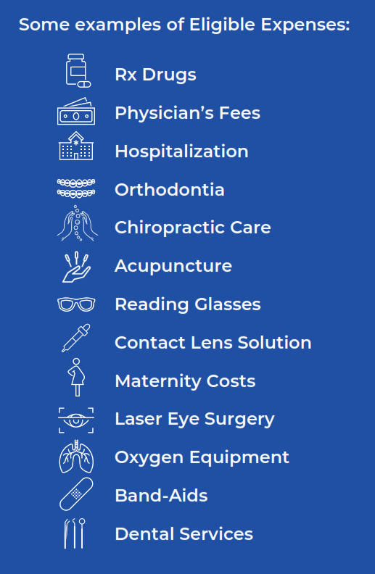
WHAT IS AN HSA?
A Health Savings Account, or HSA, is an individually owned account used to save and pay for qualified medical expenses.
Contributions are tax-free
Earnings and investment growth are tax-free
Withdrawals for qualified expenses are tax-free
Your Money, Your Account
Funds roll over each year — no “use it or lose it”
You keep it if you change jobs or retire
After age 65, HSA funds can be used for non-medical expenses without penalty.
A list of Eligible Healthcare Expenses can be found in IRS Publication 502, http://www.irs.gov/pub/irs-pdf/p502.pdf .
Notes:
A Health Savings Account or HSA, is an individually owned account used to save and pay for qualified medical expenses. When you contribute to your HSA through your health plan, Enstor takes your HSA contributions out of each paycheck on a pre-tax basis, which decreases your taxable income.
You’ll also earn interest on HSA funds tax-free.
The best part – spending is tax-free when HSA funds are used for qualified health care expenses!

Slide 22
HSA | SAVING FOR HEALTHCARE
CONTRUBITIONS CAN BE MADE UP TO THE IRS ANNUAL MAXIMUM LIMIT
✅ Are enrolled in a qualified HDHP
🚫 Are not covered by any non-HDHP medical plan (including a spouse’s)
🚫 Are not enrolled in Medicare
🚫 Are not claimed as a dependent on someone else’s tax return
CONTRUBITIONS CAN BE MADE UP TO THE IRS ANNUAL MAXIMUM LIMIT
If you are enrolled in a qualified High-Deductible Health Plan (HDHP) you can open an HSA, with the following exceptions.
The limits for 2026 are $4,400 for individuals, $8,750 for family coverage, and $1,000 catch up for 55 and older.
Like a traditional savings account, the cash account in your HSA is FDIC insured.
The annual HSA contribution limit will include any contributions made by Enstor.
ENSTOR CONTRIBUTES TO YOUR HSA!
$850 Employee Only Coverage.
$1,500 Employee + Family Coverage.
Notes:
As you contribute to your HSA, keep the IRS limits in mind. For 2026, those limits are $4,400 for individual coverage, $8,750 for family coverage, and $1,000 catch up for 55 and older employees. These limits include any contributions from Enstor.
Enstor uses a 2-tier contribution approach, with contributions of $850 for Employee Only and $1,500 for employee + family coverage. Contributions are made in two payments to your HSA Bank account. The first contribution will be made in January 2026, and the second contribution will be made in July 2026.

Slide 23
DENTAL PLAN
Administered by
Blue Cross Blue Shield of Texas

Slide 24
DENTAL PLAN BENEFITS & BI-WEEKLY COST
Benefit | Coverage |  | Employee Contributions
Annual Maximum Benefit | $1,500 per person |  | Employee | $4.96
Individual / Family Deductible | $50 / $150 |  | Employee + Spouse | $10.47
Preventive & Diagnostic Care | 100% |  | Employee + Child(ren) | $11.51
Basic Services | 80% |  | Employee + Family | $18.23
Major Services | 50%
Orthodontics (Adult & Dependent Children to age 19) | 50%
Orthodontics Lifetime Maximum | $1,500
2026 premiums paid over 27 pay periods
Out-of-Network coverage is subject to balance billing.
Notes:
With the dental plan, you can see any dentist you choose, but keep in mind you will pay less when you see a dentist who participates in the BCBSTX Dental PPO network. Under the plan, Orthodontia is covered for adults and children to age 19, and preventive and diagnostic care is offered at no cost to you. Dental contribution for the 2026 plan year has decrease slightly.

Slide 25
VISION PLAN
Administered by
VSP

Slide 26

VISION BENEFIT OVERVIEW
WellVision Exam | Prescription Glasses | Contacts
Thorough eye exam every 12 months | Lenses & frames every 12 months | You can choose contacts instead of glasses every 12 months
Prescription Glasses
Prescription glasses, covered after a $25 copay Lenses every 12 months
  Single vision, lined bifocal, and lined trifocal
  Shatter-resistant polycarbonate lenses for children
Frame every 12 months
  $150 standard allowance
  20% savings on the amount above your allowance
  To find a wide selection of featured brands, visit vsp.com
Contact Lenses
Choose contacts instead of glasses every 12 months
Up to $10 copay for your contact lens exam (fitting and evaluation)
$150 allowance for contact lenses
Apply your materials allowance toward the purchase of any contact lens brand of your choice
Notes:
When you visit a VSP provider, your WellVision Exam is covered every 12 months after you pay your $10 copay.
You can also purchase Prescription glasses or contacts every 12 months after you pay your $25 copay.
Your vision benefits are 100% paid for by Enstor.
The details of your vision plan are shown here.
There’s no ID card necessary.

Slide 27
LIFE & DISABILITY INSURANCE
Administered by
UNUM

Slide 28

BASIC LIFE AND BASIC AD&D INSURANCE
Eligible employees receive Basic Life and Basic AD&D insurance equal to one times their basic annual earnings up to $300,000.
No medical forms / authorization necessary.
This benefit is 100% paid for by Enstor.
Notes:
Enstor provides eligible employees with basic life and AD&D insurance equal to one times their annual earnings. With this benefit, there are no medical forms or authorization necessary.

Slide 29



VOLUNTARY LIFE INSURANCE
For You | For Your Spouse | For Your Child(ren)
1x to 5x your annual base salary up to $500,000 rounded up to the next $1,000. Increments of $10,000 Guaranteed issued amount of $100,000. Any amount over the guaranteed issue amount will require EOI. | Up to the lesser of 50% of your coverage or $250,000. Increments of $10,000 Guaranteed issue amount of $10,000. Any amount over the guaranteed issue amount will require EOI. | Live Birth to 6months: $1,000 6months to Age 26: $10,000 Increments of $1,000
Voluntary Life and AD&D will not be an active enrollment in Paycom. Any changes or enrollments need to be sent to hr@enstorinc.com.
Notes:
Voluntary Life can be purchased separately for all employees (you do not have to purchase both Life and AD&D) but voluntary coverage MUST be elected for the employee before dependent coverage is elected.

Slide 30

VOLUNTARY AD&D INSURANCE
For You | Voluntary Family AD&D
Increments of $10,000 up to the lesser of 10x your annual base salary or $500,000 | Equal to a percentage of your AD&D coverage: 50% for spouse, if no children 40% for spouse if eligible children 15% for children, if no spouse 10% for children if eligible spouse
Voluntary Life and AD&D will not be an active enrollment in Paycom. Any changes or enrollments need to be sent to hr@enstorinc.com.
Notes:
Voluntary AD&D can also be purchased separately for all employees. Again, you do not have to purchase both Life and AD&D insurance, but voluntary AD&D coverage MUST be elected for the employee before Voluntary Family AD&D is elected.
Remember Voluntary life and AD&D will not be an active enrollment in Paycom. Any changes or enrollments need to be sent to hr@enstorinc.com.

Slide 31
VOLUNTARY LIFE AND VOLUNTARY AD&D INSURANCE
CURRENTLY ENROLLED | VOLUNTARY LIFE AND/OR VOLUNTARY AD&D
EMPLOYEE VOLUNTARY | INCREASES
As we transition to a new carrier this year, employees and their eligible dependents who did not previously enroll in voluntary coverage will have the opportunity to elect coverage up to the Guaranteed Issue amount. Additionally, those who enrolled in coverage but did not elect the full guaranteed issue amount may increase their coverage up to that limit without submitting an Evidence of Insurability (EOI) Form.
If you are increasing your coverage over the guaranteed amount, you must submit an EOI (Evidence of Insurability) form to UNUM.
Premiums will not be adjusted in payroll until the EOI has been approved by UNUM.
Contact HR for EOI instructions.
SPOUSE VOLUNTARY LIFE | INCREASES
VOLUNTARY AD&D
If you are increasing your spouse life coverage over the guaranteed amount, the employee must be enrolled in Voluntary Life and an EOI form has to be submitted to UNUM for approval.
Premiums will not be adjusted in payroll until the EOI has been approved by UNUM.
Employee and Family Voluntary AD&D does not require an EOI.
Notes:
Voluntary AD&D can also be purchased separately for all employees. Again, you do not have to purchase both Life and AD&D insurance, but voluntary AD&D coverage MUST be elected for the employee before Voluntary Family AD&D is elected.
Remember Voluntary life and AD&D will not be an active enrollment in Paycom. Any changes or enrollments need to be sent to hr@enstorinc.com.

Slide 32



DISABILITY INSURANCE | STD & LTD
First 7 Days (Elimination Period) | Short Term Disability | Long Term Disability
PTO Replaces 100% of your pay. | Approved STD replaces 100% of your pre-disability earnings for two weeks. Then the benefit reduces to 60% to a weekly maximum of $2,500. Benefit begins after elimination period and disability has been approved by UNUM. | LTD replaces 60% of your pre-disability earnings to a $10,000 monthly maximum. Benefit begins after 26 weeks of disability, and the benefit duration is based on the employee’s age when the benefit commences. LTD is paid directly from UNUM.
Notes:
Short Term Disability benefits are payable on the 8th day of an accident or an illness. If disabled, you will be paid 100% of your weekly earnings for 2 weeks, then the benefit payable will be 60% up to 26 weeks.
The first seven days of an accident or illness are considered your elimination period. You may use PTO during that time.
After 26 weeks, if you are still disabled, you may be eligible for Long Term Disability benefits. Long Term Disability pays 60% of your monthly earnings, to a max of $10,000 per month.
Short and Long-Term Disability premiums are paid for by Enstor at 100%. These benefits are taxable.

Slide 33
UNUM VALUE-ADDED BENEFITS | AVAILABLE 24/7
Employee Assistance Program | Secure Travel Assistance | Financial, Legal & Estate Assistance | Be Well
Get support for you and your family members with things like depression, grief or loss, family, marital, or relationship issues, life improvement and goal setting, financial or legal concerns, and more. | Provides pre-trip planning, assistance while traveling, and unlimited medical evacuation and repatriation benefits when traveling 100 miles or more from home. | Provides financial and legal support regarding estate settlement, social security, cash flow, taxes and investment planning. | Provides valuable incentive for important tests and screenings for employee and covered family member.
Notes:
We recognize life can at times be challenging, that’s why Enstor provides benefits to help you along the journey of your life. No situations is too big or too small. When you and your household members need assistance, reach out any time and we will help get you on the right path to meet your needs. From checking off daily tasks to working on more complex issues, UNUM offers a variety of resources, tools and services available to you and your household members.

Slide 34
ACCIDENTAL INJURY, CRITICAL ILLNESS & HOSPITAL INDEMNITY INSURANCE
Administered by
UNUM

Slide 35
ACCIDENTAL INJURY INSURANCE
Accidental Injury Insurance pays a fixed benefit according to the schedule. This is a group accident “off the job” insurance policy.
Examples
Emergency Care Treatment: $75
Physician Office Visit, includes Urgent Care $50
Hospital Stay $250 per day
Accidental Injury insurance can be purchased independently or alongside an Enstor medical plan, to help supplement your coverage. However, you must enroll yourself in order to enroll your spouse. Limitations and exclusions may apply.
Accidental Injury cost is based on plan choice and tier.
Please review the plan documents for more information regarding coverage and cost.
Notes:
Accidental injury insurance pays a fixed benefit according to the schedule. This is a group accident “off the job” insurance policy.
Accidental Injury insurance can be purchased independently or alongside an Enstor medical plan, to help supplement your coverage. However, you must enroll yourself in order to enroll your spouse. Limitations and exclusions may apply.

Slide 36
CRITICAL ILLNESS INSURANCE
We know that everyone has different needs when coping with a critical illness. With your UNUM Critical Illness insurance, you receive a lump sum payment if you are diagnosed with a covered critical illness, like cancer, heart attack or stroke.
You choose how to spend or save your benefit. It can be used for expenses, such as:
Paying for childcare or help around the house
Travel costs to see a specialist
Medical treatment and doctor visits
Copays and deductibles
Prescription drug costs
Critical Illness insurance can be purchased independently or alongside a Enstor medical plan, to help supplement your coverage. However, you must enroll yourself in order to enroll your spouse. Limitations and exclusions may apply.
Critical Illness cost is calculated based on age and election amount.
Please review the plan documents for more information regarding coverage and cost.
Notes:
We know that everyone has different needs when coping with a critical illness. With your UNUM Critical Illness insurance, you receive a lump sum payment if you are diagnosed with a covered critical illness, like cancer, heart attack or stroke.
Critical Illness insurance can be purchased independently or alongside an Enstor medical plan, to help supplement your coverage. Limitations and exclusions may apply. Please review the plan documents for more information.

Slide 37
HOSPITAL INDEMNITY INSURANCE
A hospital stay can happen at any time, and it can be costly. UNUM Hospital Indemnity insurance helps you and your loved ones have additional financial protection. We can help cover these unexpected events – so you can focus on getting better.
With Hospital Indemnity insurance, you get a benefit paid directly to the covered person, unless otherwise assigned, after a covered hospitalization resulting from a covered injury or illness. You can use the money to help pay for:
Paying for childcare or help around the house
Copays, deductibles or coinsurance
Follow-up care
Hospital Indemnity insurance can be purchased independently or alongside a Enstor medical plan, to help supplement your coverage. Limitations and exclusions may apply. Please review the plan documents for more information.
Hospital Care Insurance is calculated based on age and election amount.
Please review the plan documents for more information regarding coverage and cost.
Notes:
A hospital stay can happen at any time, and it can be costly. UNUM Hospital Indemnity insurance helps you and your loved ones have additional financial protection. We can help cover these unexpected events – so you can focus on getting better.
With Hospital Indemnity insurance, you get a benefit paid directly to the covered person, unless otherwise assigned, after a covered hospitalization resulting from a covered injury or illness.
Hospital Indemnity insurance can be purchased independently or alongside an Enstor medical plan, to help supplement your coverage. Limitations and exclusions may apply. Please review the plan documents for more information.
Hospital Indemnity insurance is calculated based on age and election amount.

Slide 38
IDENTITY THEFT PROTECTION
Administered by
Norton LifeLock

Slide 39
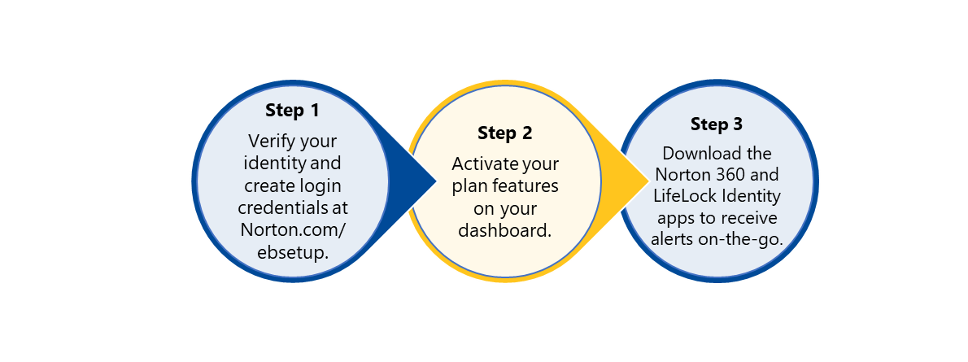

IDENTITY THEFT PROTECTION
To ensure that your identity, devices and privacy have the protection you need, Enstor offers Norton LifeLock’s Identity Theft Protection Program.
Identity Theft Protection
Device security
Online privacy (Member must take action to activate this protection)
Parental control (Member must take action to activate this protection)
Activate your membership in 3 easy steps:
Cost
Employee Only $17.99
Employee + Family $32.98
Notes:
LifeLock plan provides access to identity consultation and advice, credit monitoring, full-service identity restoration, alerts, and 24/7 life member support. See your benefit guide for more information on available services.
All employees that wish to enroll in this benefit will need to enroll for the 2026 plan year. This benefit is an Employee Paid benefit, and you will be responsible for all premiums associated with this coverage.
Costs on the slide are monthly.

Slide 40
RETIREMENT ACCOUNT
Administered by
Empower Retirement

Slide 41


401(k)
Enstor employees may choose to contribute to a 401(k)-retirement plan, administered by Empower Retirement.
The 2026 401k contribution limit has not been released by the IRS. We will update you once this has been released.
The projected 2026 401k contribution limit for employees under 50 is $24,500, a $1,000 increase from 2025. The catch-up contribution limit for those age 50 and over is projected to rise to $8,000, while the higher catch-up limit for those age 60-63 could increase to $12,000. *Please refer to the IRS website www.irs.gov for confirmed 2026 amounts.
Enstor currently matches employees’ contributions dollar for dollar up to 5% of the employee’s earning.
You can change the amount of your contributions or stop your payroll contributions at any time on Empower’s website.
Don’t forget to update beneficiaries in Empower.
Notes:
Enstor employees may choose to contribute to a 401(k)-retirement plan, administered by Empower Retirement.
The 2026 401k contribution limit has not been released by the IRS. We will update you once this has been released.
As a new employee, you are eligible to participate in the Enstor 401(k) Retirement Plan held at Empower Retirement.
Enstor will match 100% on the first 5% of your contribution
For further information about the Plan please review the Summary Plan Description (SPD).

Slide 42
REMINDERS & NEXT STEPS

Slide 43

REMINDERS
ENROLLMENT
PROVIDER CARDS
Complete enrollment in Paycom
Open Enrollment Deadline is November 21, 2025
This year’s Open Enrollment will be an ACTIVE ENROLLMENT
  Voluntary Life and Voluntary AD&D are not a part of the active enrollment, and any changes or enrollments need to be sent to HR
New BCBSTX Medical and Dental ID cards will be mailed
VSP does not have ID cards for members, simply provide your personal information to the vision provider
If you are currently enrolled in the HSA, you will not receive a new HSA bank card.
Questions? Contact Human Resources at hr@enstorinc.com
Notes:
Please remember to complete enrollment in Paycom
Open Enrollment Deadline is November 21, 2025. This year’s Open Enrollment will be an ACTIVE ENROLLMENT.
Voluntary Life and Voluntary AD&D are not a part of the active enrollment, and any changes or enrollments need to be sent to HR
New BCBSTX Medical ID cards will be mailed; BCBSTX Dental does have an ID card for distribution however you pay print a temporary one from the website if you wish.
VSP does not have ID cards for members, simply provide your personal information to the vision provider.

Slide 44
APPENDIX

Slide 45
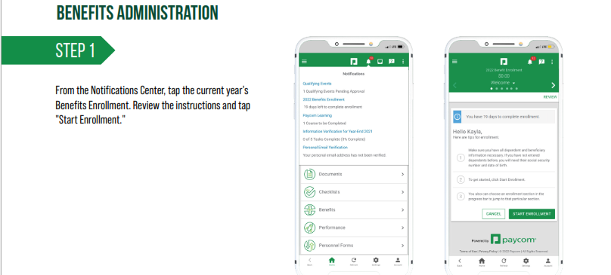
PAYCOM INSTRUCTIONS

Slide 46
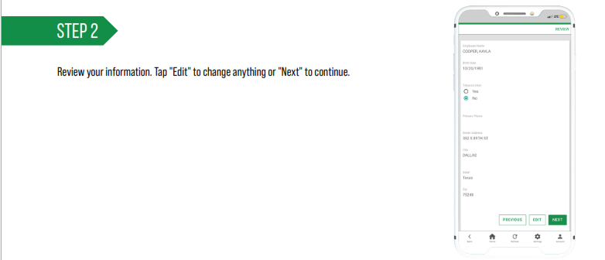
PAYCOM INSTRUCTIONS

Slide 47
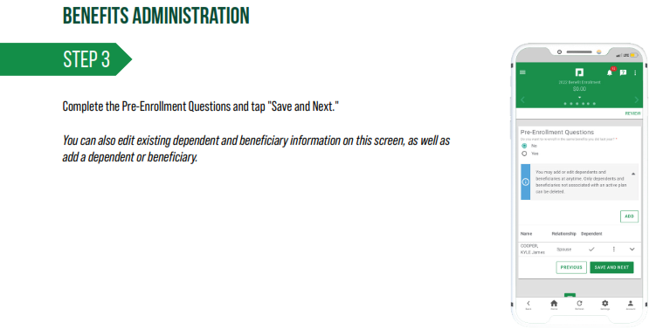
PAYCOM INSTRUCTIONS

Slide 48
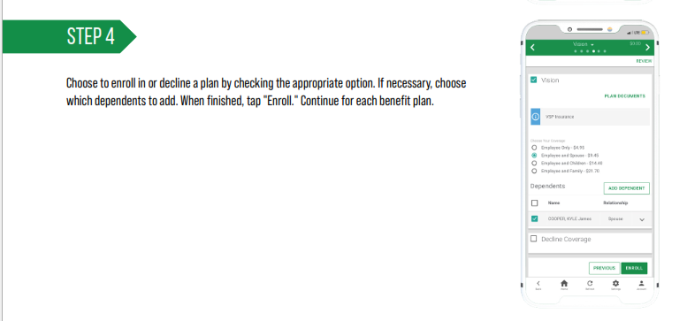
PAYCOM INSTRUCTIONS

Slide 49
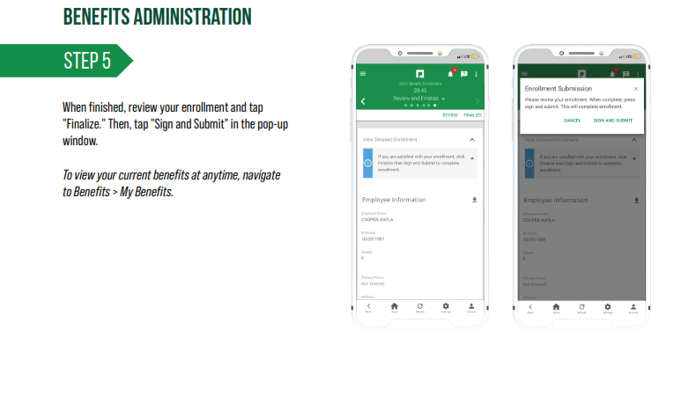
PAYCOM INSTRUCTIONS

Slide 50
Notes:
Thank you!

